Slide 1

Developing foundational quantitative data skills: the UK Data Service training programme
Dr Vanessa Higgins
Director of Training and User Support, UK Data Service
Social Statistics and Cathie Marsh Institute, University of Manchester

Slide 2
Overview
The UK Data Service training programme
Interesting and relevant projects:
Resources for Higher Education teaching
Pilot asynchronous training for 3 Doctoral Training Partnerships
Results of qualitative research with students
Development of a data skills framework for quantitative data skills
Notes:
ABSTRACT:
Foundational quantitative data skills are an essential element of statistical literacy for social scientists, but they are often overlooked in favour of more advanced methods. This session will explore the national programme of quantitative data skills training available from the UK Data Service. The programme provides a combination of synchronous online training events and asynchronous on-demand training materials targeted at a foundational level, with a focus on the skills needed to manage, find, access and use data assets such as Census data, government survey data and national longitudinal/cohort studies. These data are valuable research resources that could be used more widely for social research and policymaking if quantitative data literacy skills were more widespread among social scientists. The presentation will describe the purpose and reach of the training and will present recent developments including the results from a research project to explore the impact of the training on students who participate in it, a pilot asynchronous data skills training programme we have developed in partnership with three Doctoral Training Partnerships, and the development of a data skills framework for quantitative data skills training.

Slide 3
UK Data Service
Funded by Economic and Social Research Council
Largest repository of social science research data in UK
Provides access to data: survey microdata, UK census data, longitudinal data
Delivered by 5 partners: Universities of Essex, Manchester, Edinburgh, UCL & JISC.
2024-2030 – new grant
Training remit:
Mostly remote training via online events and asynchronous online learning resources
Audience - anyone - students, researchers, HE teaching staff, non-academics

Slide 4
UK Data Service: training topics
Build capacity in 3 core topics:
Research Data Management | Finding and Accessing Data from the UK Data Service | Using data (foundational skills)
Data management planning: sharing, archiving and preserving data Anonymisation and licence/access frameworks Documentation and metadata standards Ethical and legal considerations | Data discovery How to access data Safe Researcher Training for the most confidential data | Introductions to data we hold: Datasets e.g Census, LFS Data types e.g Surveys Substantive themes e.g Crime Evaluating data for research Preparing data/data handling Basic data analysis skills Basic software/tools Teaching with data User conferences Computational Social Science Reproducible research
At the heart:
Getting started with secondary data analysis
Foundational level
User support and training for the data that we hold (Survey, Census, Longitudinal, Cohort, International Aggregate)
What we don't do:
Advanced methods training
Advanced statistical analysis training
Advanced coding training

Slide 5
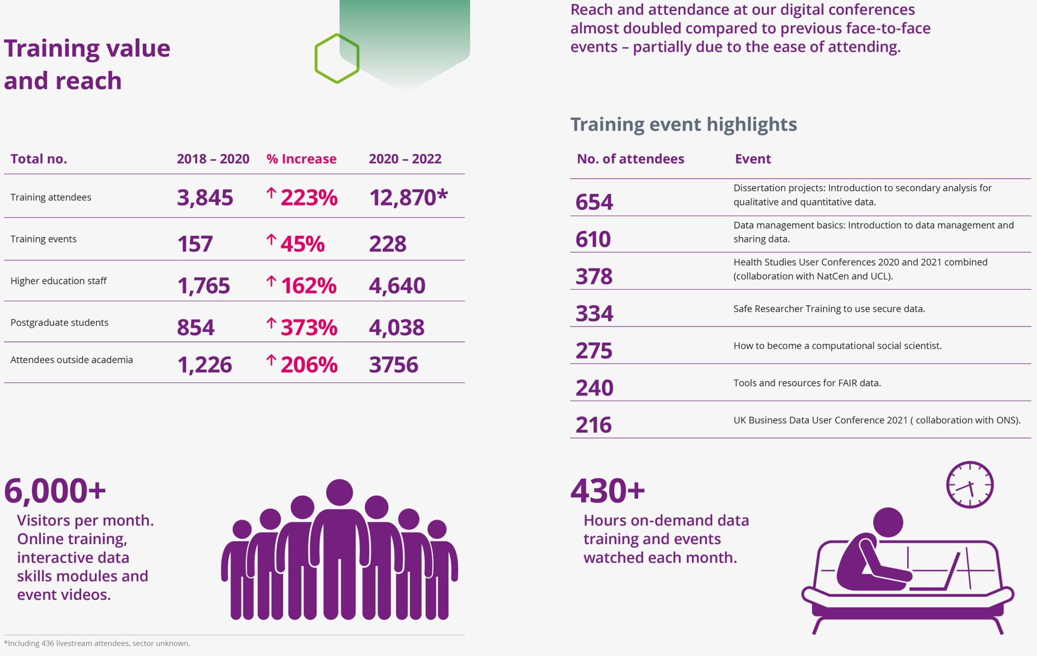

10k +7k YouTube

Slide 6
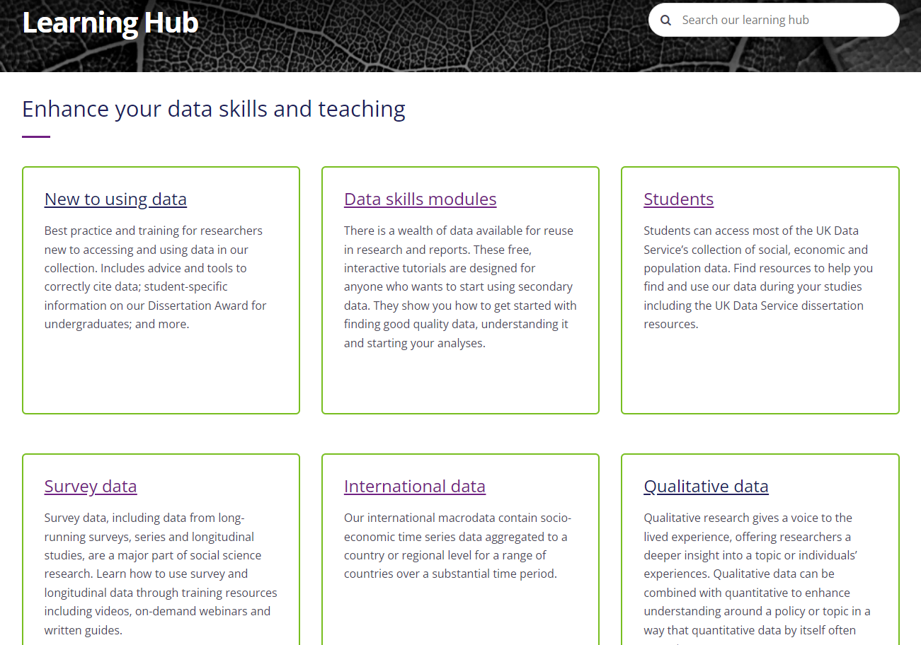
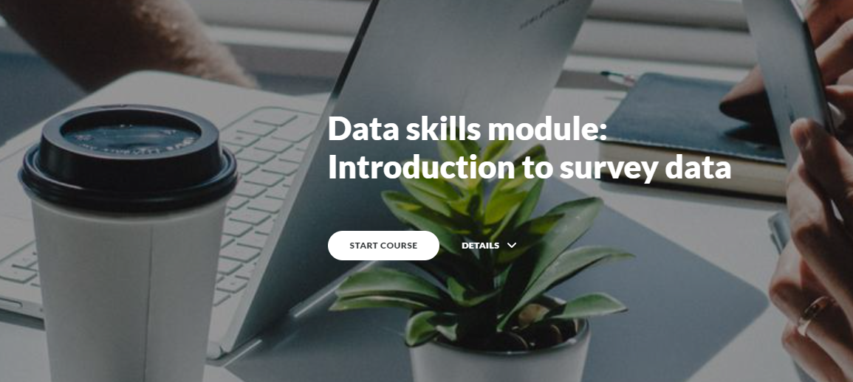
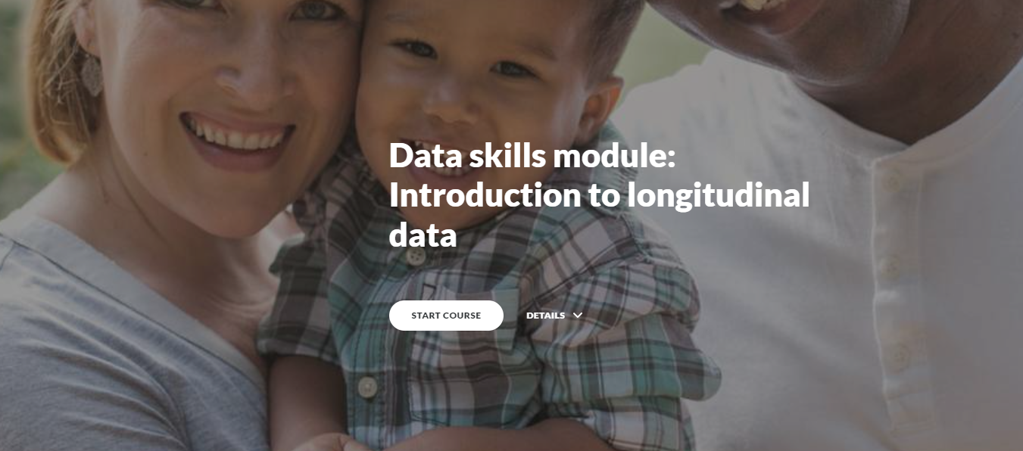
Asynchronous training: Learning Hub and YouTube
www. ukdataservice.ac.uk

Slide 7
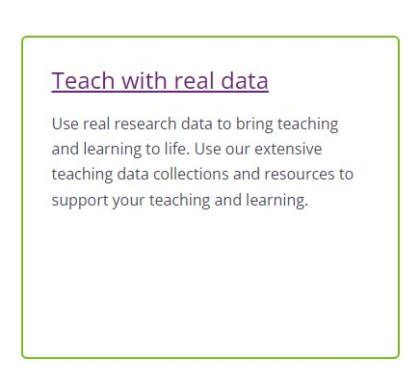
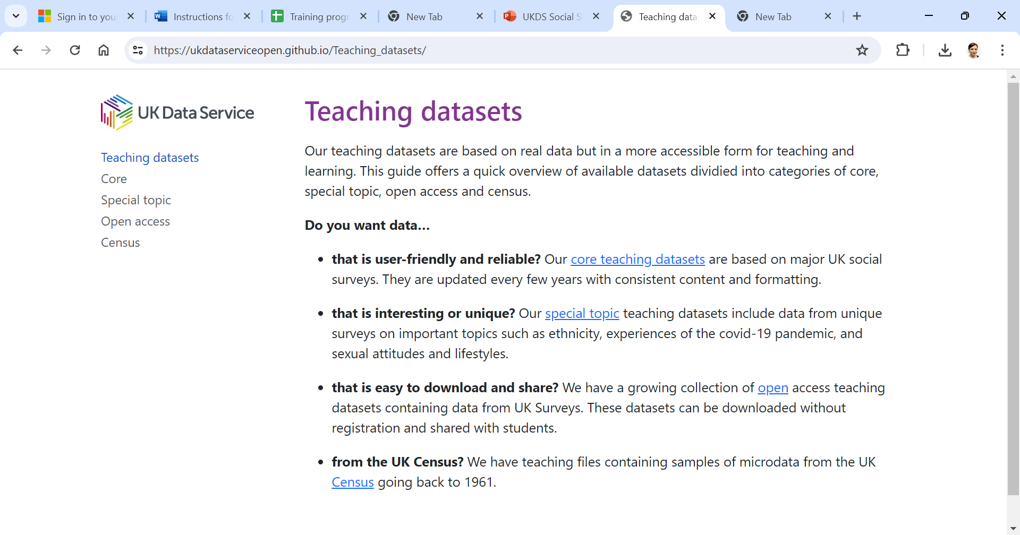
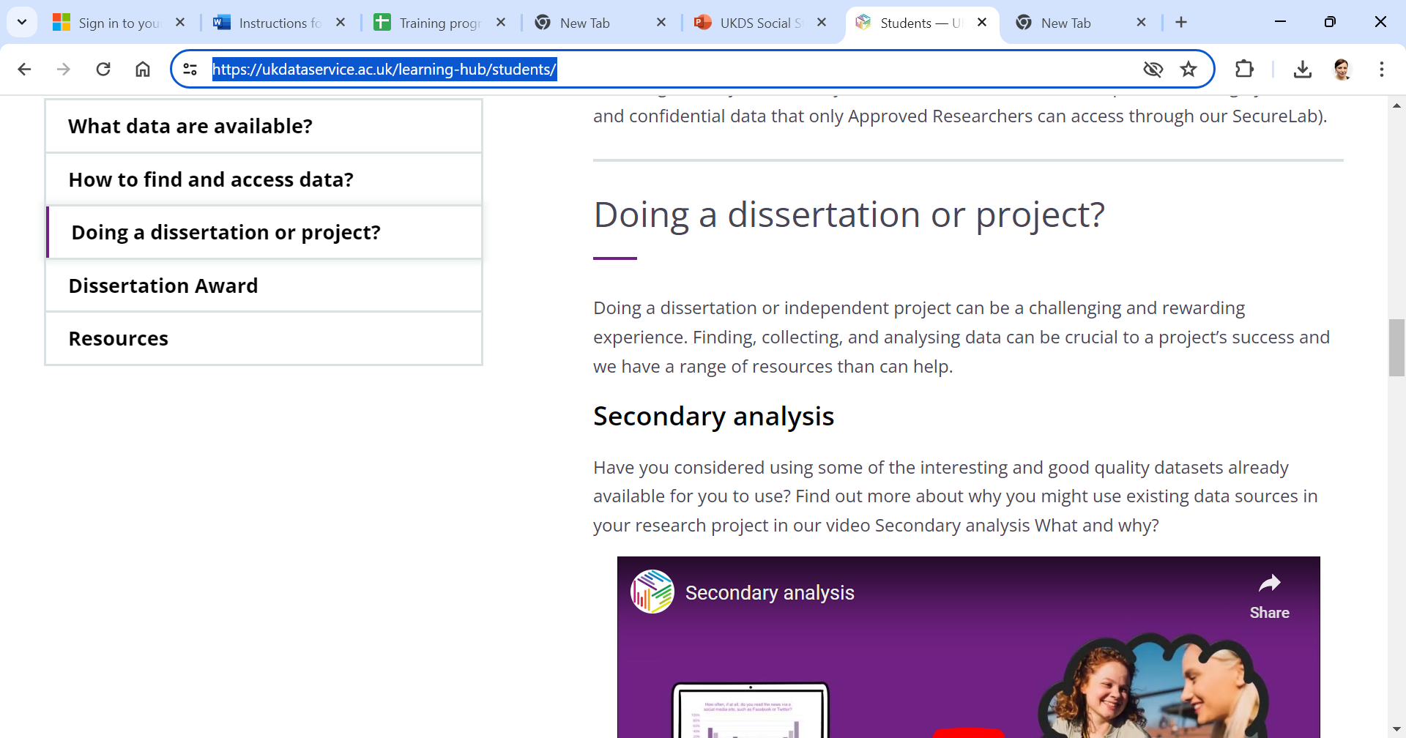
Projects/resources for HE Teaching
Consult to understand context and needs: Teaching with data: Findings from the UK Data Service Higher Education
Teach with real data - area of our Learning Hub
Access to data for teaching including teaching datasets
Student area of our learning hub, including our annual Dissertation Award (spread the word!)
What's next? themed guides for students, simple guide to ethics for secondary data, international datasets, teaching reproducibility
Ideas and collaborations welcome!
Notes:
The UK Data Service ran a consultation with higher education (HE) teaching staff in 2021.
Aim was to gather information to help the UK Data Service understand how to support the use of quantitative data from the UK Data Service within teaching and learning in HE.
Methods:
Survey : Through non-probability sampling, the survey received 109 valid responses.
Participants came from varied disciplines and career stages, but most were lecturers or above and sociology and politics were the most common disciplines.
Nearly half the sample indicate they have substantial experience of quantitative data and methods and the teaching of quantitative methods.
Interviews:
Three interviewers carried out 16 interviews online via Zoom. The interviews combined open questions and participant evaluation of existing teaching resources produced by the UK Data Service.
Teaching datasets
Our teaching datasets are based on real data but in a more accessible form for teaching and learning. Whether looking for something user-friendly, interesting, or easy to share with students, you can find a range of datasets designed with teaching in mind.
To see what’s available, our online guide to our teaching datasets previews our:
User-friendly and reliable core teaching datasets based on major UK social surveys. They are updated every few years with consistent content and formatting.
Special topic datasets based on unique surveys relating to ethnicity, experiences of the covid-19 pandemic, and sexual attitudes and lifestyles.
Open access teaching datasets. easy to download and share? We have a growing collection of open access teaching datasets containing data from UK Surveys. These datasets can be downloaded without registration and shared with students.
Census microdata data teaching files. We have teaching files containing samples of microdata from the UK Census going back to 1961
Summary of results of HE consultation:
What data is used in teaching and why?
60% used UKDS data, most common were BSA, Usoc, CSEW and Census
Pref for real-world data
Students interests important
Size and complexity of dataset – prefer small and simple. But will vary data depending on what teaching. Need for continuous variables.
Access and licensing – some don’t like UKDS for this reason.
Lecturer familiarity
2. Teaching resources
Info about datasets and ideas/examples for teaching would be most useful
3. Software
SPSS most widely used (73%). Stata and R less used (but used more by those who teach advanced courses). SPSS more student friendly. R off-putting for those nervous about maths/stats.
Suggestion to develop resources with multiple software options
4. Resources for students
Perceived barriers to second analysis (students interest, and time/skills to find and use the data).
So need resources that convey possibilities of sec analysis or help students identify useful resources
5. CSS and Reproducibility
Demos and examples of how to teach these topics would be helpful
Interest in training for lecturers on these topics
Worry the inclusion or programming and advanced stats come at expense of more general stat’l literacy, and poss alienate students.

Slide 8
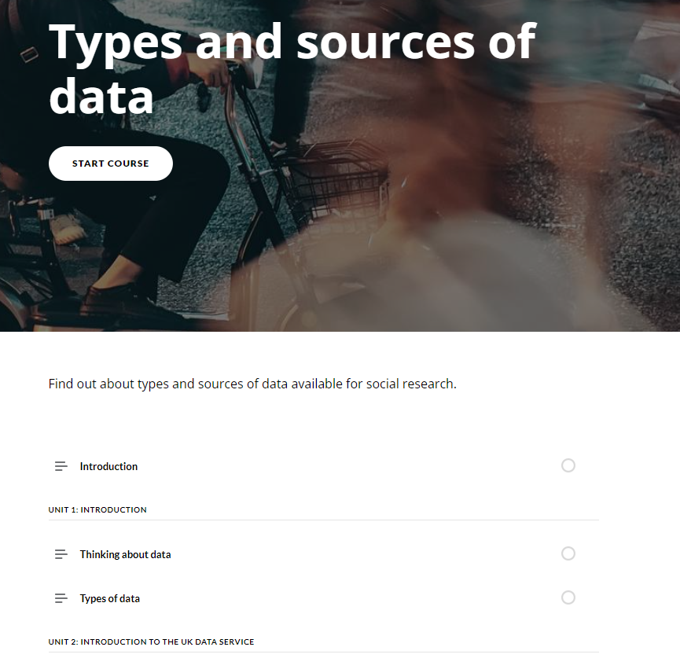
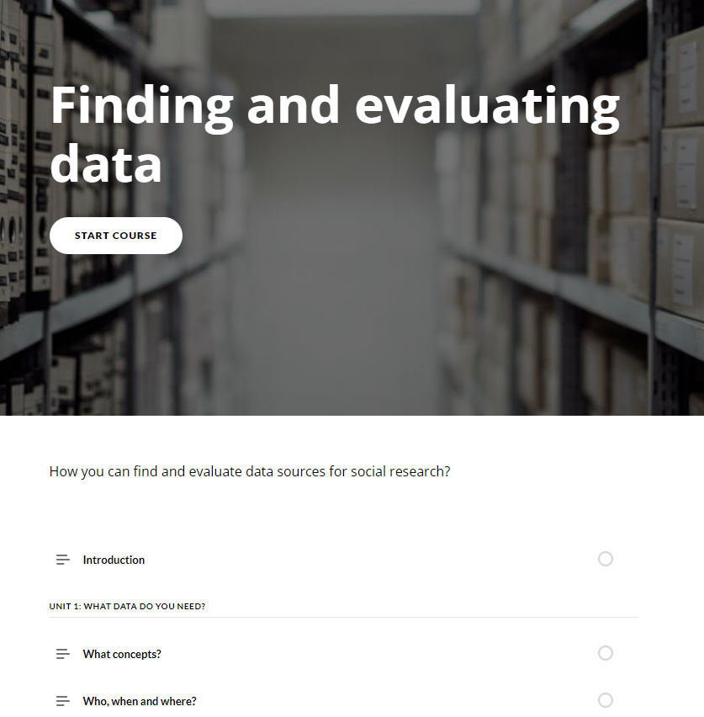
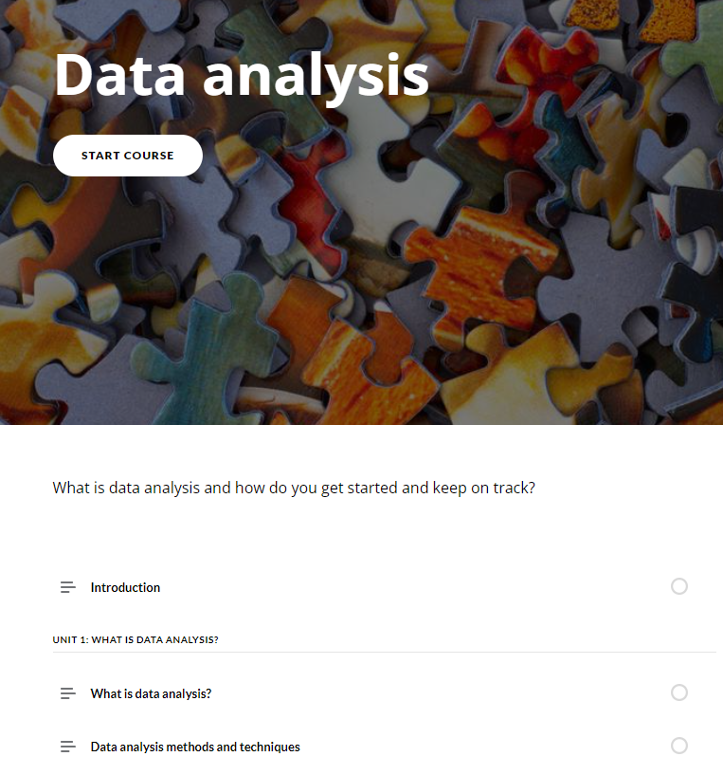
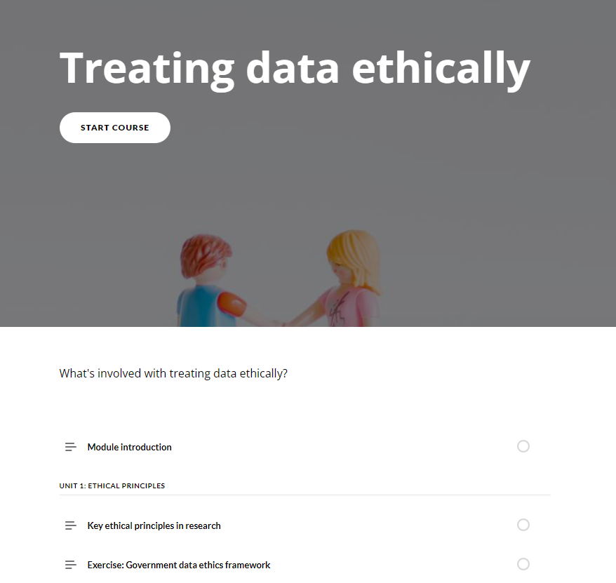
Doctoral Training Partnership (DTP) project
Drawing on the results of Data-driven research skills – UKRI
Collaboration with three ESRC Doctoral Training Partnerships (DTPs) to develop and implement an asynchronous training course
Introduction to finding and using data (4 modules)
DTPs providing funding and guidance
Initial pilot: designed and evaluated course.
Next phase: refine and embed into DTP training programs
Possible roll out to more DTPs
Notes:
Collaborating with three DTPs to develop asynchronous online course – Introductions to Finding and Using data.
Aim – high quality foundation data training for all students across institutions.
The DTPs are providing funding and guidance for the project.
We are in the initial pilot stage – which has involved designing and evaluating the course (just finished running a series of focus groups). The next phase is to refine and embed into DTP training programmes.
The UK Data Service recruited focus group participants by email from a list of Student Consultants. Students were able to join the list during the registration process. The UK Data Service contacted those who agreed by email, prompting with follow up emails if needed. There was a total of four focus group sessions. The number of participants in each group ranged from 2 to 4, with a total of 12 participants. Each session was moderated by two facilitators and lasted around 1.5 hours.
The schedule covered the following topics:
Participant background (course and university)
How they heard about the course, what interested them in signing up and how much they had completed
Initial reflections on the course – what was/wasn’t useful/helpful/enjoyable*
What they would like to keep, change, delete or add to the course*
How accessible they found the course materials and platform
Whether the course stood out among the range of training available
Any future wishes for the development of the course
Pilot report June 24.docx (sharepoint.com)
Key results:
Good take up but varied among the institutions
Generally the students like it but made some suggestions e.g. more description of content, info on how long each module will take, more consistency in when quizzes happen
They liked the interaction - partic liked practical exercises and case-studies
Bit text heavy – break up into smaller modules
More international examples
Some students indicated a preference for alternatives to the online course format, such as more interactive workshops or online lectures (both live and recorded)
Next steps: meeting DTPs next week to discuss refining the modules based on feedback, then they will embed into training programs (some will use alongside lectures)
Then if successful in the 3 DTPs we will offer it our to all DTPs.

Slide 9
Qualitative research with students
AIM: To explore how UK Data Service online training events are supporting the development of quantitative data skills in SHAPE students.
Conducted by Dr Vanessa Higgins & Professor Jackie Carter
Semi-structured online interviews (July-August 2022) with ten students, range of SHAPE disciplines, who attended UKDS online training events. Largely postgraduates.
Interview topics:
Details of current and past studies
Why attended event?
Learnt any new data skills from the event, and if so what?
Using those new skills in their current study/research?
Has training event had influenced their future plans?
Reflective thematic analysis (NVivo) using Braun & Clarke’s six-phase approach (2021)
Notes:
Aim: We focused on training events for this project (not asynchronous materials), largely due to the accessibility of the ease of obtaining a sampling frame of event attendees. We focused solely on online training events because (1) students tend to attend online more than they do FTF due to travel costs (2) at the time of the research (2021-2022), the UKDS was mostly delivering its training online due to the pandemic.
What is SHAPE?
Social sciences, Humanities, and the Arts for People and the Economy. Launched in 2020, by the British Academy,
There is a lot of reference to non-STEM or non-STEM majors. The point of us in our work focussing on SHAPE is to create a positive narrative around this but not ‘othering’ using the ’non’ as a prefix. I acknowledge this is only one definition of subjects outside of STEM.

Slide 10
Results – five themes
1. Gaining confidence to get started with quantitative data
2. Planning and designing research and assessing data sources
3. Applied, practical data skills
4. Inspiring further learning, career opportunities and cascading knowledge
5. Providing access to a research community, networking and peer-support
Journal article under review: Vanessa Higgins & Jackie Carter: Thinking Creatively About the Data Skills Gap.
Recommendations for UKDS: a data skills framework for social science students; creation of communities of practice; develop more asynchronous materials
Notes:
Info on number of interviewees (out of 10) who mentioned each theme and the number of coded quotes in each theme across all interviews e.g. for number 1, there were 7 interviewees who mentioned the theme and there were 26 coded extracts for this theme across all the interviews.
8
1. Gaining confidence to get started with quantitative data 7, 26
This theme was very strong within the qualitative data. Many of the students expressed a fear of quantitative data, particularly if they were from a qualitative background.
They used words such as “overwhelming”, “nervous”, “intimidating” and “scary” in relation to how they felt about quantitative methods
This reflects the literature and theory around maths and statistical anxiety in social science students
There was a strong sense that the training events had given the participants confidence to get started with quantitative data and to overcome the fears they had expressed - read out quote on slide“If I just get a dataset I kind of get a bit overwhelmed and think I don't really know what to do with this. I don't have a quant background and I really value attending those events because they give you an oversight of, because I guess I'm a bit more nervous about my quant skills so I, kind of, I really like being able to go to the events because they kind of break it down and explain it to you and it makes it less scary in a way”
Others used phrases such as “First step, “getting started”, “a step in the door “kick-off” and “primer”.
They described how they didn’t know where to start and how it was even difficult to describe what they were missing…..they felt stupid for asking basic questions
2. Planning and designing research and assessing data sources 10, 46
This theme was very strong and, in fact, was covered by all the student participants.
It was built upon repeated references to the students commenting that they had learnt the skills needed for the early stages of the research process, such as scoping the research and planning or designing the research, rather than conducting the research or analyses.
The participants made references to the importance of the training event for learning about the provenance of the data, the availability of the data and how to access it For instance,
“Getting the insight to how the different parts of data are collected, what's done, who's responsible for which areas, and hearing about how the information all comes together from all the different sectors.” (Participant 1, Undergraduate student)
This is no surprise given the topics that we teach at the UKDS.
Participants valued the learning they had experienced about the potential of data sources for research and how the events had helped with scoping their research design (see quote on slide) - so for this particular student the training event they attended had helped them to shape their research popsoal and dissertation, because they knew more about the kinds of data available and what can be done with it.
For another student, attending the event opened their eyes to how the data could be used for aspects of their own research area that they had not previously considered. ​
3. Applied practical data skills 8, 25
The majority of the students emphasised how useful the events were in terms of providing them with applied, practical skills.
They discussed how this was an invaluable addition to reading about research in journal articles/books or learning about the theoretical aspects of research within their academic courses.
The students described that the online events had provided practical, applied information that was missing from academic courses.
One Master’s student mentioned how it was the combination of their degree courses and the online training courses that had led to the acquisition of data skills.
In terms of the practical skills they learnt, the students emphasised that through the online events they had learnt about ethics and data management, pre-analysis data skills such as preparing and cleaning the data and awareness of what particular software tools could do.
For one student the practical impact of attending the event was particularly valuable as they were about to present their research to an ethics committee. “Was about having the confidence to know you were doing it correctly and being in front of a national ethics panel to defend some of your decisions because we had to go to **anon** Ethics Committee, it wasn't just university ethics. So, I think the workshop definitely gave me the confidence to know what I was doing.” (Participant 6, PhD student)
The students discussed how preparing and cleaning the data was an important aspect of the UKDS training because they had not been able to find this elsewhere. About how there is a lot of information available about how to interpret data, but less about how to prepare the data, how to clean it And how to use it in a practical way.” (Participant 2, PhD student)
In terms of software, the students while not learning how to use software in depth did gain sufficient information to enable them to start using those tools.
4. Inspiring further learning, career opportunities and cascading knowledge 8, 31
Theme 4: relates to how attendance at the training event(s) sparked an interest in further learning and career opportunities as well as how they had cascaded the knowledge they had learnt to others.
Students mentioned their future careers and recognised the importance of quantitative data skills for employability.
Others expressed that their attendance at the online event(s) had confirmed their interest in research or evidence-based policy as a future career, and for one specifically it has helped confirm their willingness to do a PhD in a way so that they could develop their topic properly
Several students conveyed that the event(s) they attended had also led to cascading knowledge to other students or colleagues, These extended to their postgrad peers, research teams they were working in, their supervisors and also students that they taught.
The students liked the online format of the synchronous training and highlighted the benefits of the recording of the event(s) being available on the YouTube channel for asynchronous learning, which helped them to digest content that they found difficult to follow during the synchronous training. They also mentioned how accessible it was for those who were juggling commitments.
5. Providing access to a research community, networking and peer-support 3, 8
The final theme (5) focuses on the online event(s) providing networking opportunities and access to a research community, which could be of benefit to the students in their current research and in the future.
We included this as one of the core themes from the research because it is relevant to the background literature on data skills.
Students discussed the benefits of knowing who to approach for further help with particular data skills or methods, including but not restricted to, the presenters at the event(s). This was regarded as a unique opportunity which was a direct consequence of attending the training event.
They discussed how attendance at the event(s) had highlighted individuals or organisations to approach for collaborative projects in the future, and that the impact of attendance was not restricted to their current study/project.

Slide 11
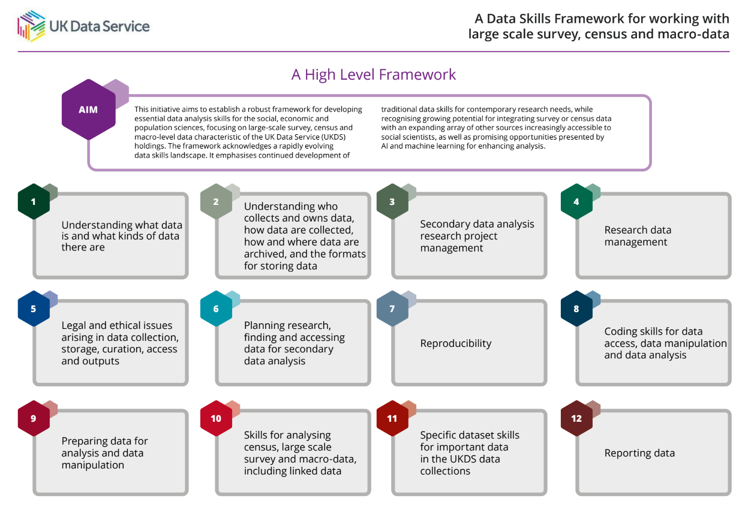
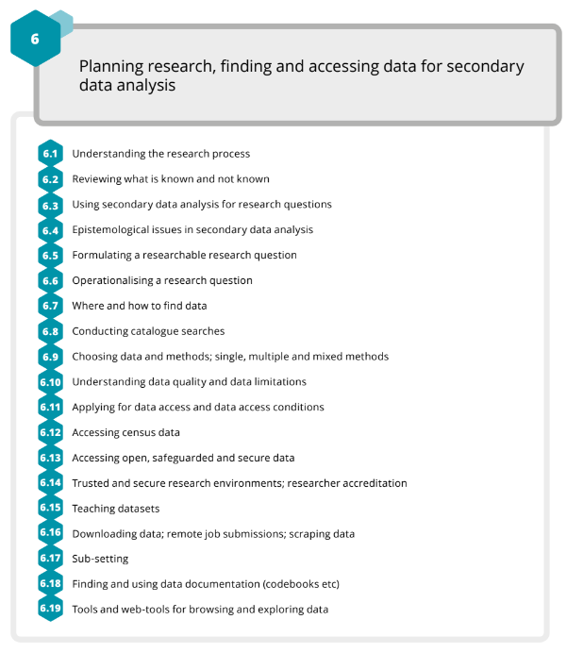
Data Skills Framework publication
Framework for building the skills needed now and into the foreseeable future for data driven analysis of social and economic issues
Skills for the quants data that we hold
Considers rapid advancement of technology and data
Consulted literature and in-house experts
Very positive feedback so far
https://zenodo.org/records/11110082​
Notes:
The aim with this Framework is not to set out training that the UK Data Service will provide, but an overview of the skills that will be needed for social and economic data analysis in the modern era, to be provided across the data skills training ecosystem.
The context in which we have developed this Data Skills Framework, and we are using it to aid our own gap analysis, training development, and strategic thinking for the next six years.
Help people know what it is they do not know – from people who do not know anything to experienced researchers; something for people to refer to across the researcher lifecourse as data, methods, and technologies evolve.
Open existing provision to broader audiences including those outside of academia;
But hope it will also assist in framing curriculum development for ourselves, other data services, universities, and other data skills training providers.
Aid consensus building on core and essential skills, skill contingencies, and varying skill-levels.
Create a template for considering parallel frameworks for other types of data/skills training [e.g. qualitative methods; smart data].
Evolve along with forms of data, computing, and new methodologies
We recognise of course that many or even most of the skills we describe will be relevant to many other types and domains of data, and we hope that others with specific training remits for those data might build on this framework, either in high level domains or sub-domains.
The data environment
Rapid advancements in technology and the availability of data present opportunities and challenges. While the research possibilities are increasing day by day, we are facing widespread societal concern about data privacy and security, and continuous developments in
legal and ethical best practice.
In developing this discussion paper, our aim has been to set out a framework for building the multiplicity of skills needed now and into the foreseeable future for data driven analysis of social and economic issues, for those working with large scale survey, census, and macrolevel aggregate data typical of the UK Data Service data holdings
Opportunities are unfolding for data linkage to our holdings with newer forms of data including web data, streaming data, and administrative data, while more data is moving into Trusted Research Environments, with data access requiring additional sets of skills to those required for traditional modes of data sharing.
Computing power means that new types of analyses are possible, with computational social science and machine learning developing at pace. New conversations are being had and cutting-edge work is being done on synthetic data, and while AI for coding and analysis is bringing new and as yet unknown uses, we have increasing levels of concern in academic
communities about verifiability and reproducibility. All this means new skills are needed, and these are constantly evolving.
However, it is very important to keep in mind that while ever more advanced skills are promised and required, foundational skills remain crucial.
Feedback:
Very positive (from wide range of people, included respected people and orgs in field of stats teaching and stats literacy –and senior folks in the data world.
Interest in whether it could be applied beyond social science and also in schools (as this was largely aimed above that level)
Rhys Jones, Professor of Statistical Literacy, (Royal Statistical Society teaching section, Education Policy Advisory Group. Trustee of the Teaching Statistics Trust, International Statistical Institute elected member. Former Associate Dean of Education at the Faculty of Health and Medical Sciences, at the University of Surrey
Prof Jackie Carter, Professor of Statistical Literacy, University of Manchester
Sophie Carr Vice President for Education and Statistical Literacy, Royal Statistical Society. Feedback received via Rhys Jones, not Sophie directly.
Mike Camden (Chair of the New Zealand Stats Association Education Committee
Len Cook (former Government Statistician of New Zealand and former UK National Statistician
Social Science Lecturers who teach with data
Zenodo metrics: high number of views and downloads
1,488 views (28 May 2024)
1,033 downloads (28 May 2024)

Slide 12




Stay connected:
www.ukdataservice.ac.uk
@UKDataService
Subscribe to our newsletter
@UKDATASERVICE
Upcoming events: https://ukdataservice.ac.uk/training-events/
Online learning resources: https://ukdataservice.ac.uk/learning-hub/
@VanessaAHiggins
vanessa.higgins@manchester.ac.uk
Thank you for listening!

Slide 13
Events feedback 2022-2023
98% Agreed that the content was interesting
98% Agreed that the content was useful for their work/studies
97% Would recommend the event to others
99% Training provided them with increased knowledge on how to use Secure Lab
99% Training provided them with increased knowledge about Statistical Disclosure Control

Slide 14































Collaborations
UK social science data skills training landscape: network meets every 3 months for signposting and collaboration
Examples of other collaborations:

